Slide 1
Edge AI-Powered Acoustic Surveillance System for Forest Protection
[Student Name 1]
ID : [Student ID 1]
And
[Student Name 2]
ID : [Student ID 2]
Department of Computer Science and Engineering
Daffodil International University

Slide 2
Outline
1. Introduction
2. Background Study / Literature Review
3. Gap Analysis
4. Objective and Motivation
5. Novelty of this Study
6. Datasets, Tools and Techniques
7. Proposed Methodology
8. Expected Outcomes
9. Q & A

Slide 3
Introduction
Global Forest Degradation & Biodiversity Crisis
Forests cover 4.06B hectares (31% Earth's land area) supporting 90% terrestrial biodiversity.
Global forest loss: 10–25 million hectares annually, driven predominantly by illegal logging.
Limitations of Traditional Monitoring
Manual ranger patrolling: Expensive, labor-intensive, hazardous, and fails to provide 24/7 coverage.
Remote monitoring need: Automated, low-power, continuous acoustic surveillance in deep forests.
Acoustic Signal Surveillance Opportunity
Distinct acoustic signatures: Chainsaws, tree cutting, gunshots, vehicles, and human activity emit clear sound profiles.
Proposed Edge AI Solution
TinyML on ESP32-S3 MCU: 27.4 KB INT8 model classifying 20 sound categories with 9.5 ms latency.
Perpetual autonomous operation: Solar-harvested power system with adaptive dual-mode LoRa + GSM telemetry.

Slide 4
Background Study/Literature Review
Paper / Author | Year | Method & Architecture | Classes | Key Results & Platform
Singh et al. (IEEE Sensors J.) | 2024 | STHT Spectrogram + SVM | 5 Classes | 96.61% Accuracy (32-bit MCU + LoRa)
Singh et al. (IEEE Systems J.) | 2024 | Gammatone Wavelet + PSO-SVM | 4 Classes | 98.55% Accuracy (32-bit MCU)
Ayankoso et al. (JDMD) | 2024 | 1D CNN + LSTM Ensemble | 3 Classes | 89.14% Accuracy (RPi Pico + LoRa)
Mohmmad et al. (IEEE Access) | 2026 | TCN + Transformer Attention | 4 Classes | 97.48% Accuracy (Requires GPU)
ForNet (Scientific Reports) | 2026 | CNN Embeddings + XGBoost | 5 Classes | 91.40% Accuracy (Server-based)

Slide 5
Gap Analysis
Gap 1: Severely Restricted Sound Taxonomy
All 33 reviewed papers classify only 2–5 sound classes; real forest protection requires multi-class (15+) threat coverage.
Gap 2: Lack of True Microcontroller Edge Deployment
High-accuracy models (97%+) rely on GPU/cloud servers; MCU implementations handle only 2–3 basic classes.
Gap 3: Short Battery Autonomy & No Solar Budget
Existing nodes last only 4–10 hours on battery; no prior work provides a complete solar harvesting budget.
Gap 4: Single-Mode Telemetry Vulnerability
Systems rely solely on LoRa (fails without gateway) or GSM (high battery drain); no adaptive dual-mode system exists.
Gap 5: Analog Signal Noise & Lack of PCEN
Analog electret mics suffer from noise; Per-Channel Energy Normalization (PCEN) has never been applied to forest acoustics.

Slide 6
Objective and Motivation
Primary Research Objectives
20-Class SE-DS-CNN Model: Deploy a 27.4 KB INT8 quantized binary on ESP32-S3 with <10 ms latency.
PCEN Feature Extraction: First application of Per-Channel Energy Normalization for outdoor noise adaptation.
Solar-Sustained Node: Design power budget needing only 1.6 hours daily sunlight for perpetual 24/7 operation.
Adaptive Dual Telemetry: Combine LoRa primary + GSM fallback with MOSFET zero-standby hardware power gating.
Core Motivation
Protect Terrestrial Biodiversity: Automate illegal logging detection to safeguard endangered forest habitats.
Bridge Theory & Hardware: Transition from lab/GPU models to an affordable (<$50), field-deployable TinyML sensor node.

Slide 7
Novelty of this Study
1. Most Comprehensive Sound Taxonomy (20 Classes)
Expands state-of-the-art from 5 classes to 20 distinct categories (4× increase in classification coverage).
2. Smallest & Fastest Edge-Deployed Forest Model
27.4 KB INT8 quantized model with 9.5 ms inference time on ESP32-S3 (Xtensa LX7 vector acceleration).
3. First Application of PCEN in Forest Acoustics
First system to utilize Per-Channel Energy Normalization for dynamic noise-floor adaptation in outdoor environments.
4. Perpetual Solar-Sustained Energy Architecture
5.4 days battery-only autonomy; requires only 1.6 hours of daily sunlight to maintain continuous 24/7 operation.
5. Zero-Standby Dual LoRa + GSM Telemetry
Primary LoRa mesh with automatic GSM SMS fallback using MOSFET hardware power gating (0 mA standby draw).

Slide 8
Datasets, Tools and Techniques
Dataset Specifications (5,200 Audio Clips) (5,200 Audio Clips) | • 20 Sound Classes: Chainsaw, Axe, Handsaw, Gunshot, Explosive, Machinery, Engine, Dirtbike, Drone, Speech, Screaming, Footsteps, Digging, Tree Fall, Campfire, Dog, Walkie-Talkie, Forest Ambient. • Sources: ESC-50, UrbanSound8K, RFCx, Google AudioSet, Freesound. • Format: 16 kHz, 16-bit Mono PCM WAV, 2s windows. 70/15/15 Stratified Split.
Hardware Stack & Sensors | • MCU: ESP32-S3 (Dual-Core 240 MHz, Xtensa LX7 Vector Extension). • Audio Sensor: INMP441 I2S Digital MEMS Omnidirectional Microphone. • Telemetry: RFM95W (SX1276) LoRa + SIM800L 2G GSM (MOSFET Gated). • Sensing & Power: Neo-6M GPS, LIS3DH Accelerometer, LiFePO4 Battery + Solar Panel.
Software Frameworks | • Python 3.x, TensorFlow / Keras, TensorFlow Lite Micro, Edge Impulse Studio. • C/C++ (Arduino IDE / ESP-IDF), Librosa, OpenPyXL, NumPy, Scikit-learn.
Signal Processing & ML | • Features: PCEN (Per-Channel Energy Normalization) & MFE Spectrograms. • Architecture: SE-DS-CNN (Depthwise-Separable Conv + Squeeze-and-Excitation). • Optimization: INT8 Post-Training Quantization, 5-Fold Cross-Validation.

Slide 9
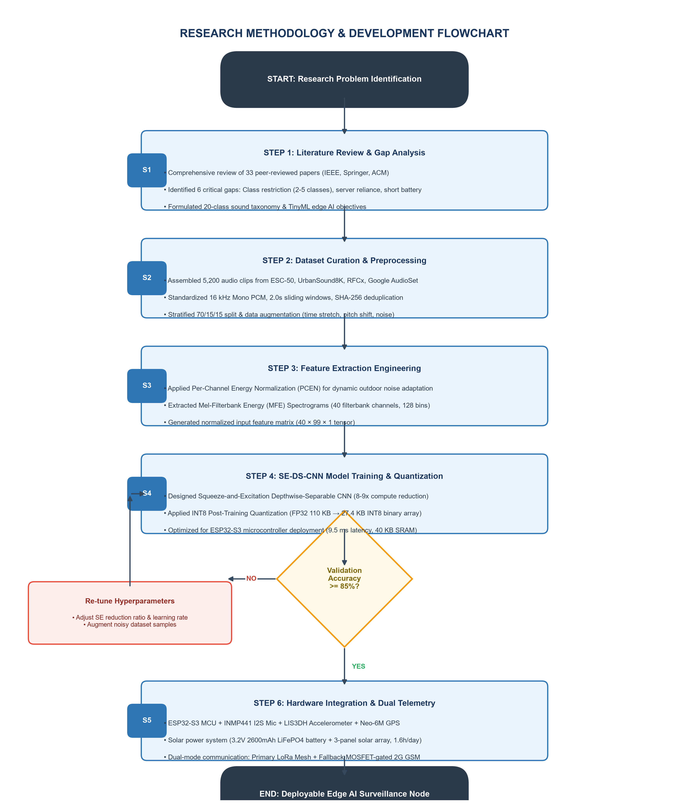
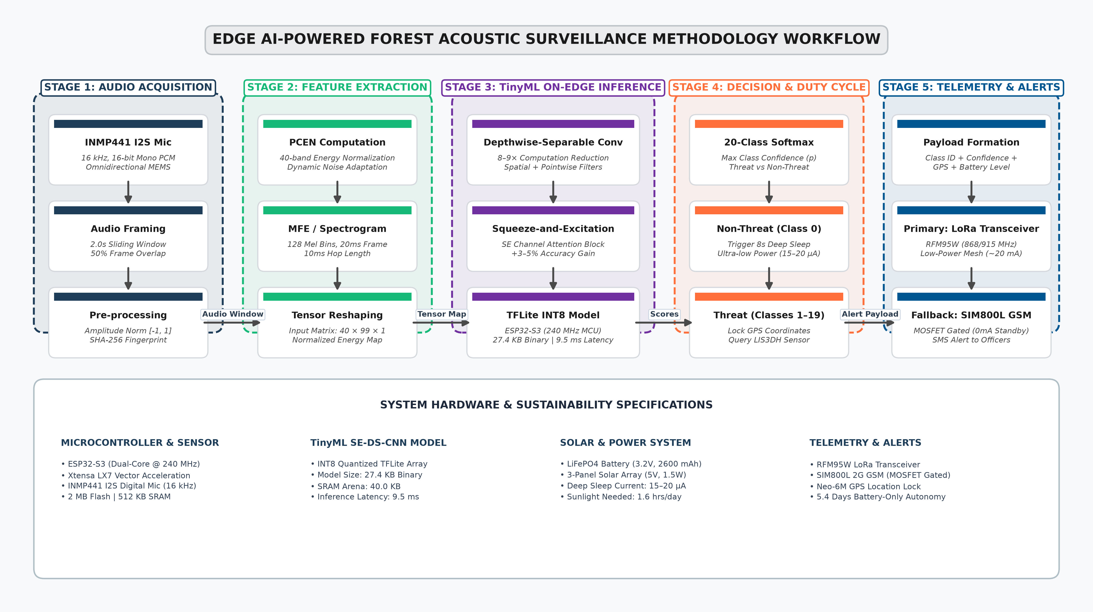
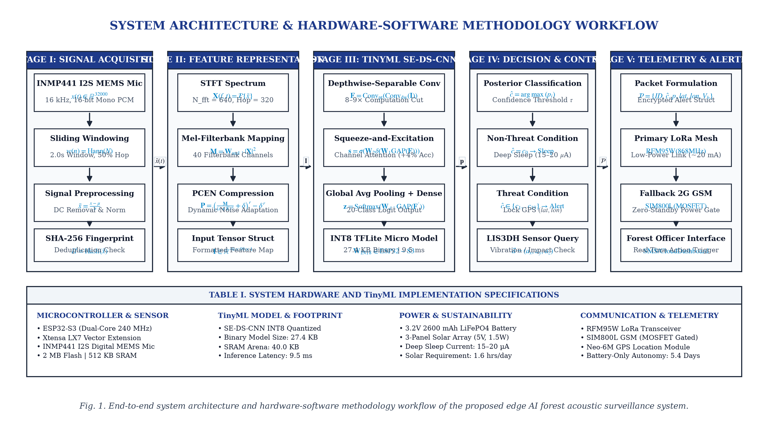
Proposed Methodology
Audio Processing Pipeline
INMP441 I2S Digital Mic (16 kHz) → PCEN/MFE Feature Extraction → SE-DS-CNN INT8 Model → Alert Engine.
SE-DS-CNN Model Architecture
Depthwise-Separable Convolutions: Reduces MAC operations by 8–9× compared to standard 2D CNNs.
Squeeze-and-Excitation (SE) Blocks: Learns channel-wise attention for frequency band weighting (+3–5% accuracy boost).
INT8 Post-Training Quantization: Compresses FP32 model (110 KB) to 27.4 KB binary array with <1% accuracy loss.
Power Management & Duty Cycle
Duty Cycle Schedule: 8s Deep Sleep (15–20 µA) → 2s Wake & Sample (~100 mA) → <200 ms Inference → Alert if Threat.
Solar-Harvested Autonomy: 5.4 days battery-only operation; requires only 1.6 hours daily sunlight for perpetual 24/7 power.
Adaptive Dual-Mode Telemetry
LoRa Primary + GSM Fallback: Sends alerts via LoRa (~20 mA); falls back to GSM SMS powered via MOSFET (0 mA standby).

Slide 10
Expected Outcomes
Phase 1 Verified Empirical Results
Overall Accuracy: 88.21% | Macro Precision: 91.26% | Macro F1-Score: 89.84%.
Perfect 1.00 F1-Score (11 Classes): Axe, Explosive, Machinery, Speech, Dirtbike, Tree Falling, Engine, Footsteps-leaves, etc.
Hardware Benchmarks: 27.4 KB INT8 Binary | 9.5 ms Latency | 40 KB SRAM Arena | 15–20 µA Deep Sleep.
Phase 2 Target Deliverables
Field-Tested Prototype: IP67 weatherproof enclosed node deployed in real forest conditions.
Accuracy Optimization: Fine-tune chainsaw/handsaw classification overlap (Chainsaw 82% → 90%+ target).
Cloud Dashboard & Mobile App: Real-time alert map and SMS notification platform for forest authorities.

Slide 11
THANK YOU
Questions & Discussion
Edge AI-Powered Acoustic Surveillance System for Forest Protection

